Slide 1
HackZon 2022
Team Pineapple 🍍
Team Members :
Nitin A
Amogh Bharadhwaj
K N Pranav

Slide 2
Project objective:
Recommendation Engine for a Travelling Library

Slide 3
Solution
In order to maximize the profits of our travelling librarian by bringing along only the books he needs and by giving him a delivery path that is the most efficient, we use the Reccomendation Engine on each of the patrons in order to select the books they are most likely to read next and calulating all of their locations based on their coordinates and generating the most effective path to deliver all the books.
We generate the the reccomended books based on the patron’s previously read books, their age, gender, preferences etc. There is also an option to add more books to the collection as well as register as a new patron.

Slide 4
Implementation of Idea into the Project
Initially we create a set of rules that need to be passed for a book to be tagged as “recommendable”.
We compile a list of recommendable books which is compiled into a list with all other patrons.
All the patrons’ locations are calculated after which the most efficient traversal route is found for the librarian.

Slide 5
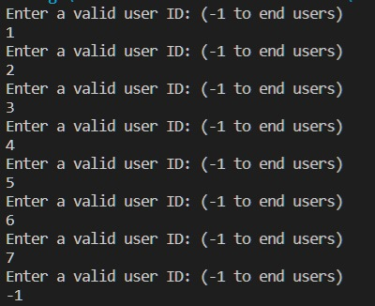
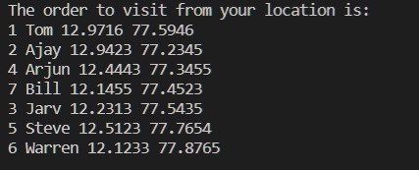
Output

Slide 6
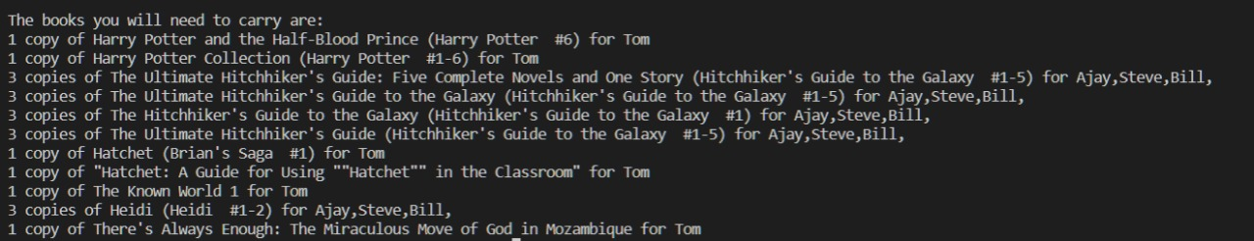
Output

Slide 7
Future scope:
The system is built in such a manner that it can be extended and refined further by just adding more rules without any other changes.
An interface would make it easier to access and modify the library index as well as add new users, for the hackathon we focused on making a solid and feasible backend.
The navigation route can be enhanced for improved accuracy.

Slide 8
Thank You
Team Pineapple

